Slide 1
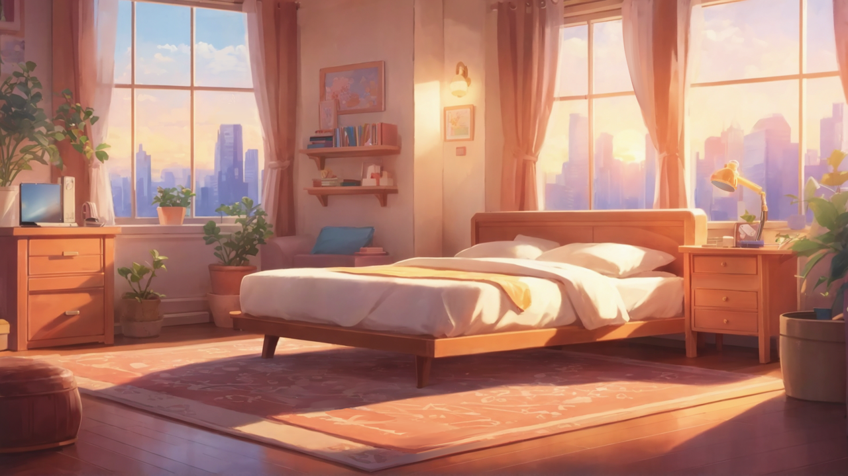

Slide 2



Aim
Notes:
a Japanese anime-style girl with brown hair tied up as two top knot, happily smiling

Slide 3

Obstacle
Notes:
a Japanese anime-style girl with brown hair tied up as two top knot, happily smiling

Slide 4

Effort
Notes:
a Japanese anime-style girl with dark brown hair tied up as two top knot, holding tightly onto a painting, looks determined

Slide 5

Effort
Notes:
a Japanese anime-style girl with dark brown hair tied up as two top knot, holding tightly onto a painting, looks determined

Slide 6

Result
Notes:
a Japanese anime-style girl with dark brown hair tied up as two top knot, sitting on floor and crying

Slide 7
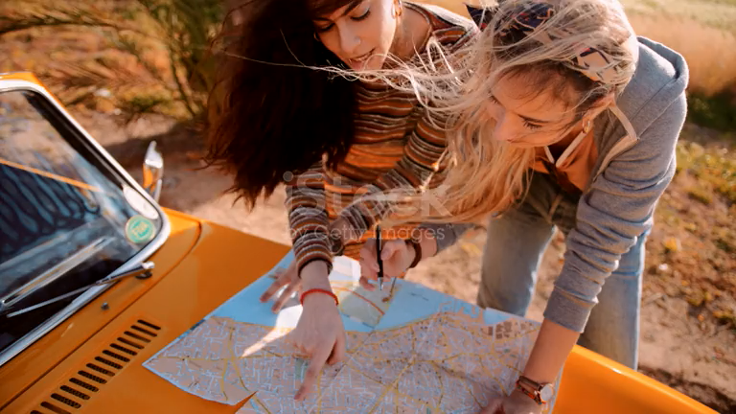
Result
Notes:
a Japanese anime-style girl with dark brown hair tied up as two top knot, sitting on floor and crying

Slide 8

Accident
Notes:
a Japanese anime-style girl with two-toned hair (left side blue-green, right side white), sitting in a forest

Slide 9

Twist
Notes:
a Japanese anime-style girl with cats ears, having two-toned hair (left side blue-green, right side white),and looking at a taller man who has lion's ears

Slide 10

Twist
Notes:
a Japanese anime-style girl with cats ears, having two-toned hair (left side blue-green, right side white),and looking at a taller man who has lion's ears

Slide 11

Ending
Notes:
a Japanese anime-style girl with cat ears, two-toned hair (left side blue-green, right side white), happily laughing with some people who have ears of animals

Slide 12
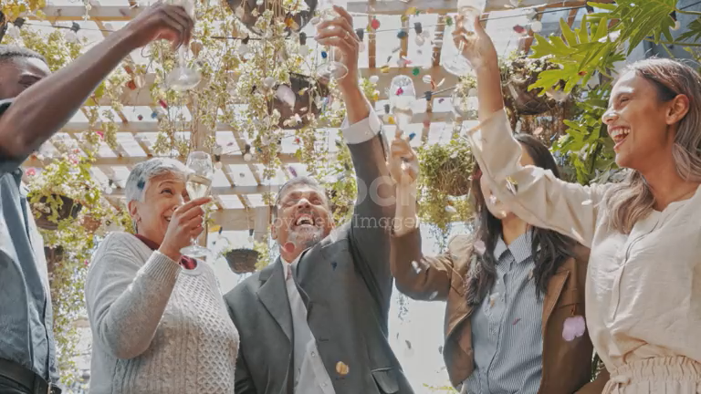
Ending
Notes:
a Japanese anime-style girl with cat ears, two-toned hair (left side blue-green, right side white), happily laughing with some people who have ears of animals

Slide 13

Ending
Notes:
a Japanese anime-style girl with cat ears, two-toned hair (left side blue-green, right side white), happily laughing with some people who have ears of animals

Slide 14

Ending
Notes:
a Japanese anime-style girl with cat ears, two-toned hair (left side blue-green, right side white), happily laughing with some people who have ears of animals

